Slide 1
Analyzing Box Office Data for Microsoft's Film Studio Venture
What Movie Genres and Strategies Lead to Success in the movie industry?
Abigail Nzambi
DVF-PT-05

Slide 2


Introduction
Microsoft is entering the competitive film industry but lacks experience in film production. To minimize risk and ensure a strong market entry, Microsoft needs evidence-based guidance on what factors lead to success in the film industry
Stakeholders: Microsoft’s new movie studio executives and strategic planners.
Challenge: To identify factors that lead to the success of a new movie production business.

Slide 3
Objectives
To analyze the distribution of movie runtimes.
To determine the average movie rating across different runtime categories.
To assess the impact of the number of genres in a movie on the average movie rating.
To evaluate the correlation between the number of genres, number of writers, number of directors, and average movie rating.
To examine the trend of movie runtimes over time.

Slide 4
Data Overview
For the analysis, I used data with key values such as Movie Runtime, Movie Genre, Average rating, Movie Directors and Movie Writers.
Some of the ways I prepared the data for the analysis, were:
Removing missing values
Removing outliers
Removing duplicates in the entries
Creating columns that would be useful in the analysis

Slide 5
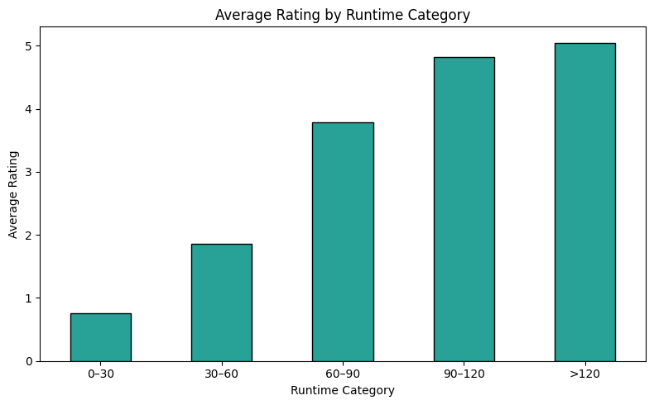
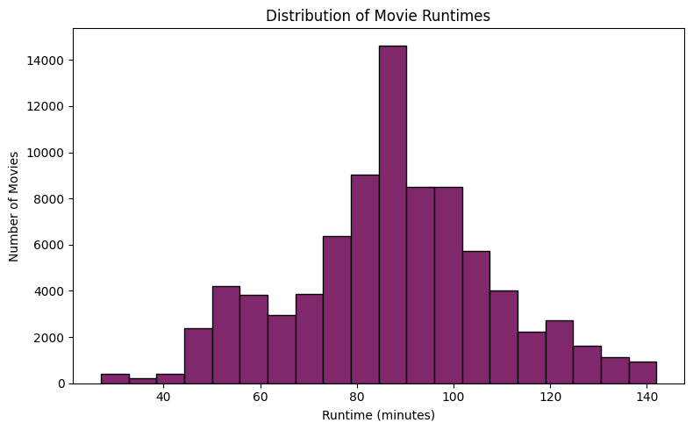
Key Findings
Most movies, about 14,500 of them, fall within the 80 to 90-minute range. There are a few significantly longer movies extending beyond 140 minutes, and very fewer short films, ie under 50 minutes.
A comparison between the length of the movies and the average ratings shows that longer movies get a higher rating than shorter movies

Slide 6
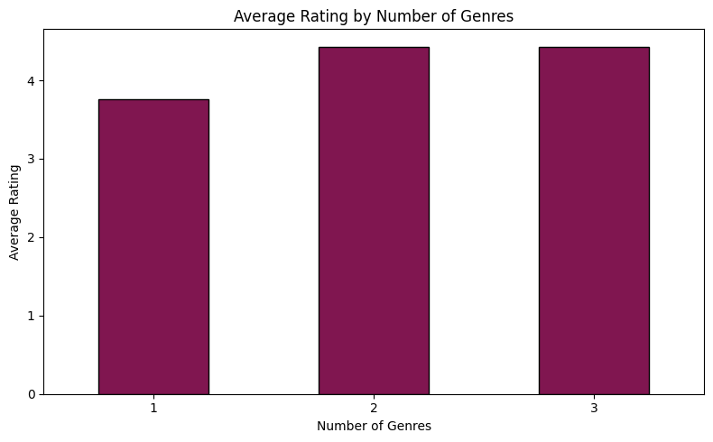
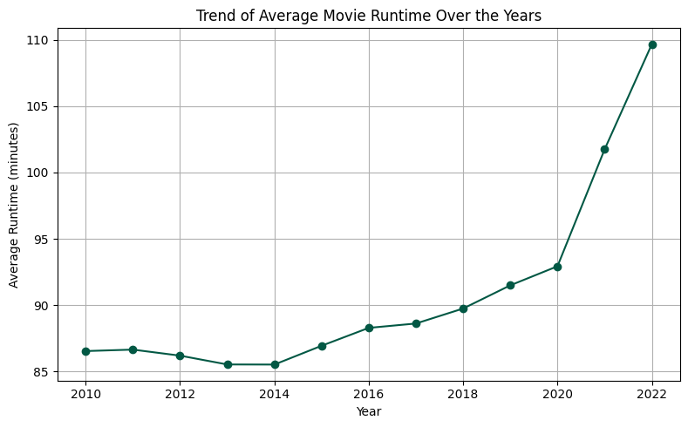
Key Findings
Between 2010 and 2019, the average runtime remained relatively stable with only gradual increases, but from 2020 onward, there's a steep upward trajectory in the average runtime
The more the number of genres a movie is, the better the rating, as shown in the bar chart above.

Slide 7
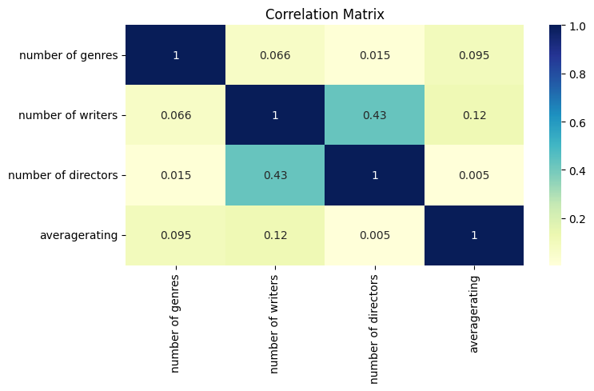
Key Findings
This chart indicates a moderate positive relationship between the number of writers and the number of directors, suggesting that projects with more writers tend to have more directors and vice versa.
The data also suggests that having more writers may slightly improve average ratings, but the impact is minimal.

Slide 8
Conclusion
Runtime Preferences: The majority of successful movies (about 14,500) fall within the 80–90 minute range.
Runtime vs. Ratings: Longer movies tend to receive higher average ratings than shorter ones.
Genre diversity: Movies that span multiple genres tend to get better ratings. This suggests that genre diversity enhances audience appeal and reception.
Team Size vs. Ratings: Larger writing teams often align with larger directing teams, and more writers might slightly improve storytelling quality, but it's not a strong factor alone.
Trend in Movie Length Over Time: There has been a sharp increase in average runtimes in the recent years, suggesting a trend toward longer films, possibly due to streaming platform influence or changing audience preferences.

Slide 9
Recommendations
Microsoft should target the 80–100 minute runtime range for movies to match current audience expectations.
Microsoft should aim for genre-blending in movies (e.g., action-comedy, sci-fi-drama) to enhance and viewer experience.
The company should build balanced creative teams of writers and directors to allow for collaborative creativity that supports higher quality films.
The company should follow the runtime growth trend. Newer movies are trending longer, particularly post-2020, therefore, it should experiment with slightly longer formats, especially for digital platforms.
These insights reduce financial risk by aligning production choices with proven market demand, and Microsoft can build a strong, profitable foundation in the film industry by working around these insights. This will give Microsoft a competitive edge in the movie production industry.

Slide 10
Thank you

